Slide 1
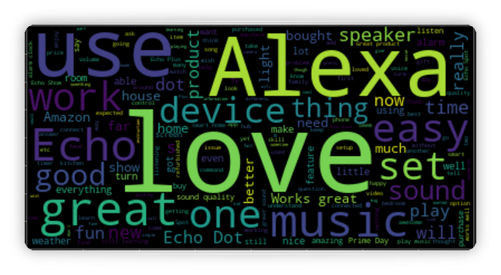
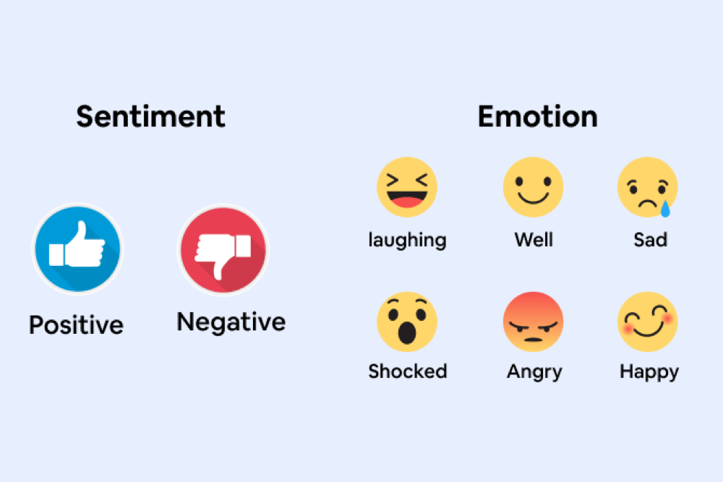



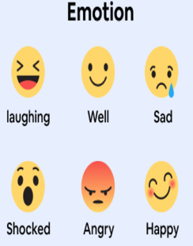

Department of Mathematics
Sharda School of Basic Sciences and Research
Sentiment Analysis of Reviews on Amazon Alexa
Submitted By:
Manvi Sharma
System ID: 2022307757
Roll No.: 2207160006
M.Sc.(Data Science & Analytics)

Slide 2
Introduction
The research focuses on understanding user sentiment towards Amazon Alexa devices through the analysis of customer reviews.
It employs sentiment analysis techniques to categorize reviews into positive or negative, aiming to uncover user emotions and opinions.
The study aims to identify areas of satisfaction and dissatisfaction among users, providing insights into the overall user experience with Alexa devices.
Advanced machine learning algorithms such as the Random Forest Classifier, XGBoost, and Decision Tree are utilized for the accurate classification of sentiments.
A comparative analysis of the models' accuracies is conducted to determine the most effective method for sentiment classification.
The research goes beyond theoretical analysis by developing a practical application using Flask for real-time text sentiment prediction.
The findings offer valuable insights for manufacturers and developers to address consumer grievances, enhance product features, and improve user engagement and satisfaction.
This study contributes to academic discussions on sentiment analysis and provides actionable intelligence for improving the success of Alexa and other intelligent voice assistants in the smart home market.

Slide 3
Literature Review
This problem is based on the following studies:
Yu et al. (2023) [9] explore the potential of XGBoost, a powerful gradient boosting algorithm, for sentiment analysis, showcasing its ability to achieve superior performance compared to other models.
Sun et al. (2022) [11] develop a sentiment analysis-based framework to monitor and analyze customer feedback on social media platforms, enabling businesses to gain real-time insights and address customer concerns promptly.
Wan et al. (2021) [1] explore the effectiveness of deep learning models for sentiment analysis on short texts like online reviews, demonstrating their superior performance compared to traditional methods.
Singh et al. (2021) [8] evaluate the effectiveness of ensemble methods, such as Random Forest, for sentiment analysis tasks, demonstrating their robustness and accuracy in handling complex datasets.
Li et al. (2020) [4] analyze Amazon Alexa reviews using Long Short-Term Memory (LSTM) networks, identifying user preferences for specific features and functionalities.

Slide 4
Mehta et al. (2020) [7] compare the performance of various machine learning algorithms, including Support Vector Machines (SVM) and Naive Bayes, for sentiment classification of product reviews, highlighting the strengths of each approach.
Zhou et al. (2020) [10] utilize sentiment analysis of online reviews to inform product recommendation systems, personalizing recommendations based on user preferences and opinions.

Slide 5
Objective
Classify Amazon Alexa Reviews.
Perform Sentiment Analysis.
Compare Machine Learning Algorithms.
Identify Key Features and Issues.
Develop a Real-Time Sentiment Prediction Application.
Enhance Product Development and User Experience.

Slide 6
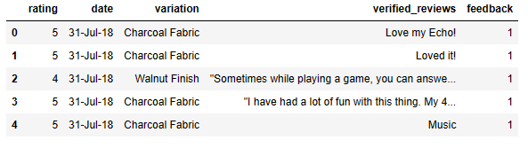
Methodology
Imported Libraries: Imported a comprehensive set of libraries for data handling, visualization, text processing, model training, and evaluation.
Load the dataset: Load the dataset using pd.read_csv function.

Slide 7
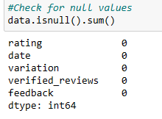
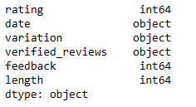
Exploratory Data Analysis (EDA): Performed an in-depth EDA,
Dataset's shape:
Checking for null values:
Datatypes of the features:

Slide 8
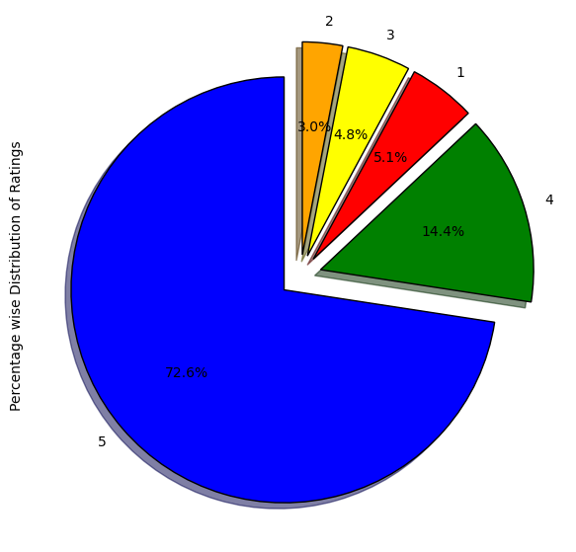
Visualize each column
Rating Column:

Slide 9
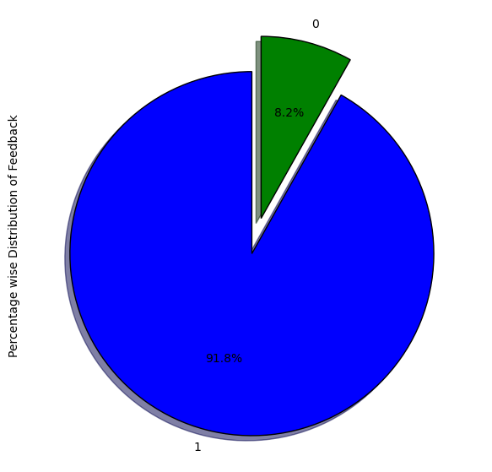
Feedback Column:

Slide 10
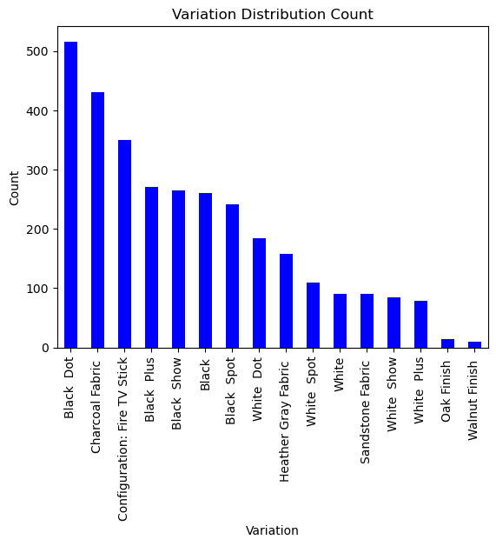
Variation Column:

Slide 11
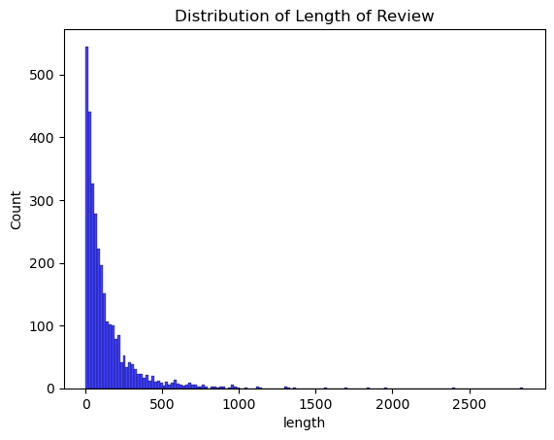
Length Column:

Slide 12
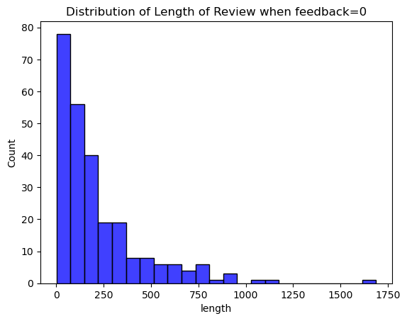

Length when feedback=0
Length when feedback=1

Slide 13
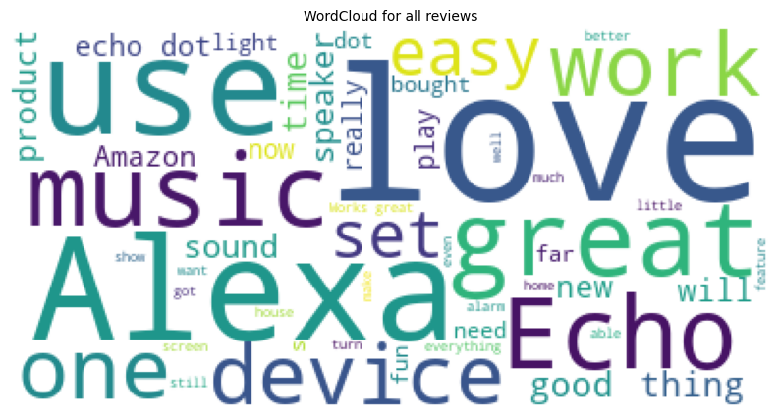
WordCloud of verified_reviews:

Slide 14
Text Preprocessing: Employed NLTK for text pre-processing, including stopwords removal, stemming, and transforming the reviews into a corpus.
Feature Engineering: Transformed the text data into numerical format using CountVectorizer and created additional features like review length.
Modeling: Trained and evaluated three models - RandomForestClassifier, XGBClassifier, and DecisionTreeClassifier. For the RandomForestClassifier, you also performed hyperparameter tuning using GridSearchCV.
Evaluation: Each model's performance was assessed using accuracy and confusion matrices.
Develop Application: Develop a practical application using Flask framework in Python for real-time text sentiment prediction.

Slide 15



Result
The accuracy of models
Decision Tree:
Random Forest:
XGBoost:

Slide 16
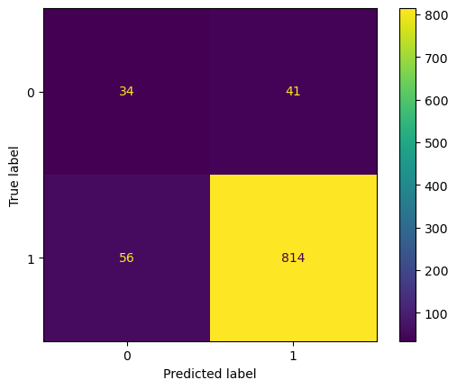
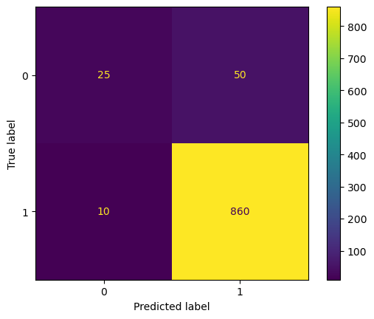

The Output of Confusion Matrix:
Decision Tree: XGBoost:
Random Forest:

Slide 17
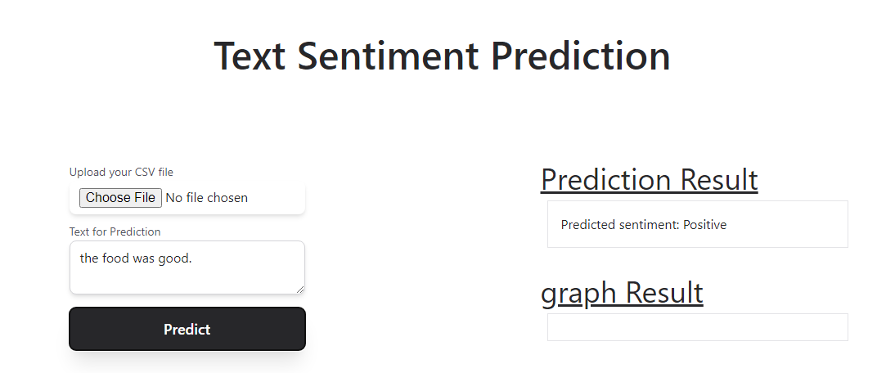
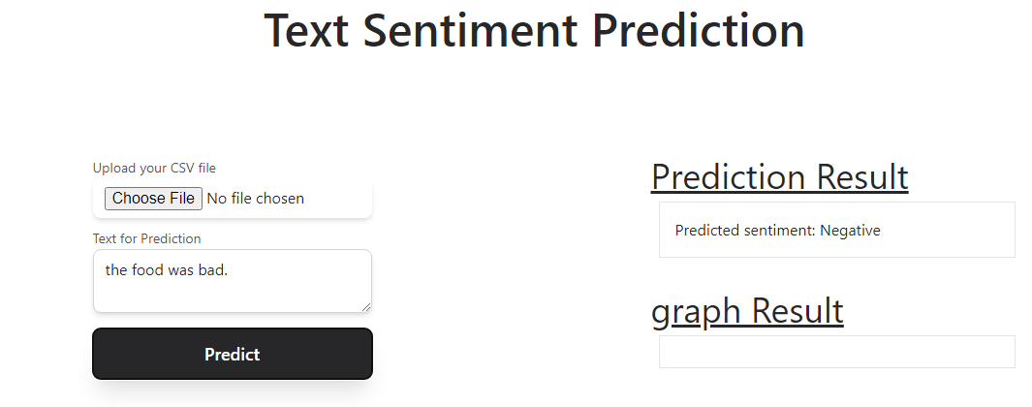
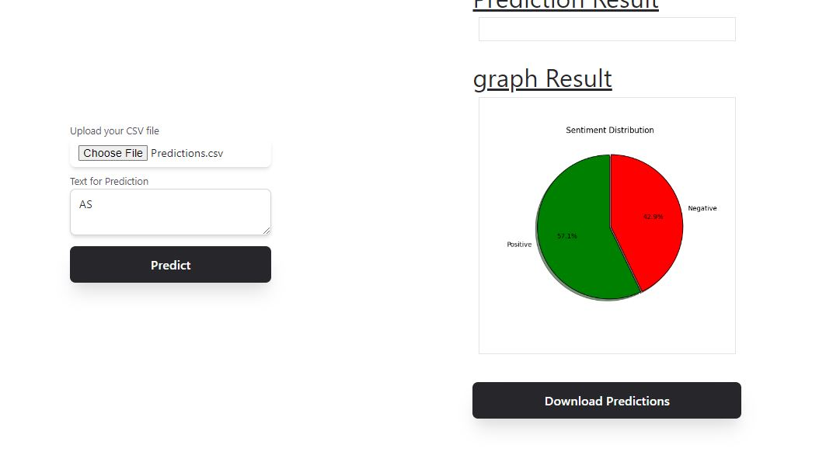
Application’s Output:
Single Prediction:
Bulk Prediction:

Slide 18
References
[1] | A. Gupta, S. Srivastava, and R. Singh, "A sentiment analysis framework for Amazon product reviews using machine learning and NLP techniques," in 2020 IEEE International Conference on Data Science and Data Intensive Systems (DSDIS), pp. 1-6, 2020.
[2] | S. Wan, Y. Cao, Y. Fang, and Z. Ren, "Sentiment analysis for short texts using deep learning," Pattern Recognition, vol. 116, p. 117822, 2021.
[3] | Y. Wang, M. Li, and H. Wang, "A sentiment lexicon for intelligent voice assistant reviews," Knowledge and Information Systems, 2023. [Online]
[4] | X. Li, H. He, X. Ren, and J. Zhao, "Sentiment analysis of user reviews for intelligent home devices using LSTM networks," in 2020 International Conference on Artificial Intelligence and Computer Science (AICS), pp. 87-91, 2020.
[5] | J. Chen, Y. Zhang, and S. Jin, "Sentiment dynamics of user reviews on Amazon Alexa: A time series analysis," in 2021 International Conference on Internet of Things (iThings) and Green Computing (iGC), pp. 1-4, 2021.
[6] | Y. Yang, Y. Wu, and R. Zhao, "Analyzing user opinions on privacy concerns of voice assistants: A case study of Amazon Alexa," in 2022 International Conference on Artificial Intelligence in Information and Communication (ICAIC), pp. 642-647, 2022.
[7] | S. Mehta, R. Kumari, and A. Sharma, "Comparative analysis of sentiment classification algorithms using product reviews," Journal of Big Data Research, vol. 10, p. 101314, 2020.
[8] | A. Singh, A. Rani, and S. Sangal, "Ensemble methods for sentiment analysis of product reviews," International Journal of Computer Applications, vol. 182, no. 13, pp. 19-26, 2021.
[9] | Z. Yu, M. Li, and F. Li, "Sentiment analysis of product reviews based on XGBoost," in 2023 International Conference on Computational Science and Computational Engineering (CSCE), pp. 181-185, 2023.
[10] | K. Zhou, Y. Chen, C. Yang, Z. Liu, and Z. Chen, "Sentiment analysis-based personalized recommendation system for online shopping platforms," IEEE Access, vol. 8, pp. 7765-7774, 2020.
[11] | M. Sun, H. Yu, and Y. Wang, "A sentiment analysis framework for analyzing customer feedback on social media," Journal of Information Science, vol. 48, no. 4, pp. 840-853, 2022.

Slide 19
Thankyou

